Slide 1
Strings and text data

Slide 2
Strings
Collection of characters
WSYWIG
Numbers can be stored as bytes
But numbers can also be stored as strings

Slide 3
Cleaning Data
Applying structure to data
Looking for patterns in our data and using those patterns to our benefit
With tagged data looking for specific tags we need
With text files, might be looking for specific words/phrases to exclude or as markers
<page sequence="2">326 International Organization By elaborating on Robert Brenner's theory of social property relations,
<page sequence="3">IR in the Middle Ages 327 action with a theory of sociopolitical structure. This, I suggest, should be
<page sequence="4">328 International Organization On the basis of changing social property relations,
<page sequence="5">IR in the Middle Ages 329 intemational system. In this perspective, systemic qualitative

Slide 4
Characters
String characters have positions
Workshop : 8 characters
Not only the case with words but also collection of words
Columbia Text Workshop : 22 characters – Spaces count!

Slide 5
Whitespace
Areas between words, paragraphs, lines, etc.
Includes characters such as spaces, tabs (“\t”), line breaks (“\n”)
We can use whitespace to separate into words

Slide 6
Matching text
Whitespace can also be problematic for matching text
“Kissinger “ ~= “Kissinger”
Strip white space from ends of string
But not from the middle

Slide 7
Regular expressions
Sequence of characters that define a search pattern
Good for:
Parsing data
Finding specific patterns of text
But:
Best when understand context

Slide 8
Regex options
Match or not
Was the search pattern found?
Start and end position or length of match
Where in the string was the pattern found?
Match pattern
What string was found?

Slide 9
Syntax
Similar across programs
Couple of regex standards

Slide 10
Regex groups
[A-Za-z] – search for any letter, upper or lower
[0-9] – search for any digit
\s – search for any space
\S – search for any not space
[[:punct:]] – search for punctuation characters

Slide 11
Regex operators
^ - search from beginning of string
$ - search at end of string
\ - escape character (“\$”) to search for dollar sign
+ - at end of group, searches for pattern
[] - Search for any of the characters (useful with groups such as A-Z)
[^] – Search for anything but the character following the caret

Slide 12
Example
1. BARBADOS 272/01/P 22
2. 111474
3. E. FEATHERSTONE
4. 272 - BARBADOS, WEST INDIES
5. M.D.I.
6. (A) CABLE, CALL OR WRITE 6. (B) MR. WINSTON A. HASSELL, MANAGING DIRECTOR 6. (C) GASS PRODUCTS LIMITED CHEAPSIDE P.O. BOX 22 BRIDGETOWN, BARBADOS, W.I.
7. CABLE: "GASPRO", BARBADOS; TELEPHONE: 62958 OR 62959
8. --
9. 101
10. DESCRIPTION: DEPARTMENT PLEASE SUPPLY SIC NUMBER. SMALL SCALE (2-10 TON) LIQUID OXYGEN/NITROGEN GENERATING PLANT. FIRM STATED IT WAS INTERESTED IN PURCHASING SURPLUS UNITS FROM U.S. DEPARTMENT OF DEFENSE ORIGINALLY MANUFACTURED BY SUPERIOR AIR PRODUCTS CO. FOR USAF BUT MANAGING DIRECTOR STATES THAT HE WOULD LIKE TO RECEIVE QUOTATIONS FROM ANY U.S. SUPPLIER.
ESTIMATED PURCHASE: US DOLS 25-75,000. FIRM IS MEMBER OF INTERNATIONAL OXYGEN MANUFACTURING ASSOCIATION.
COMMENTS: FIRM IS BARBADOS' SOLE PRODUCER OF INDUSTRIAL AND MEDICAL GASES. LATEST WTDR (BRIDGETOWN 0634 OF 4/10/74) INDICATES SUITABLE CONTACT FOR U.S. FIRMS. SIMMS

Slide 13
Regular expression warnings
Regex tends to be greedy
It pulls in as much context as it can
("\d+\\..+”) will pull any number of digits followed by a literal but then pull everything after the period
Matches exact pattern
("\d+\\.”) will pull any number of digits and then the literal period, but that will include numbers at the end of the sentence
Need to be very clear on what we want
If we only want bulleted items, we could use (\s)(\d+\\.)

Slide 14
Other warnings
Misspellings:
'|C0NTACT', '|CONACT', '|CONCTACT', '|CONTACT', '|CONTACTl', '|CONTACt', '|CONTRACT', '|COTACT'
Regular expressions will not catch them
Makes it more difficult to parse data

Slide 15
Text data
How do we analyze text?
How is text data stored
Convert text to numbers
Traditional methods: frequency of words/tokens used
New methods: text as vectors of numbers
Why?
Computers cannot read
Analysis based on math which requires numbers
Notes:
Traditional methods -> new methods—preservation of semantics/meaning

Slide 16
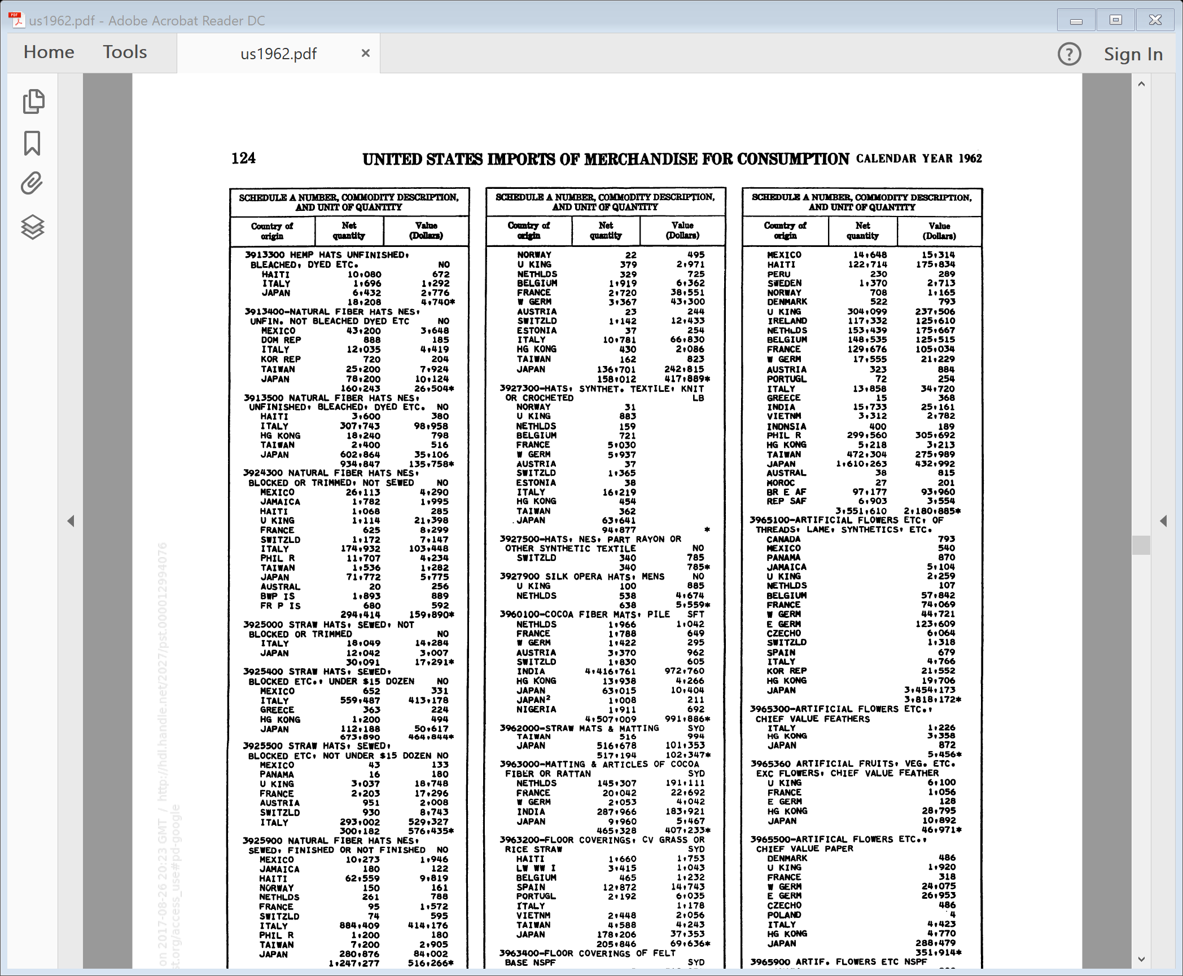
Numeric data structures
Commodity | Description | Country | Value
3913300 | Hemp hats, unfinished, bleached, dyed, etc | HAITI | 672
3913300 | Hemp hats, unfinished, bleached, dyed, etc | ITALY | 1292
3913300 | Hemp hats, unfinished, bleached, dyed, etc | JAPAN | 2776
3913300 | Hemp hats, unfinished, bleached, dyed, etc | WORLD | 4740
3913400 | Natural fiber hats, nes, unfin, not bleached, dyed, etc | MEXICO | 3648
3913400 | Natural fiber hats, nes, unfin, not bleached, dyed, etc | DOM REP | 185
3913400 | Natural fiber hats, nes, unfin, not bleached, dyed, etc | ITALY | 4419
3913400 | Natural fiber hats, nes, unfin, not bleached, dyed, etc | KOR REP | 204
3913400 | Natural fiber hats, nes, unfin, not bleached, dyed, etc | TAIWAN | 7924

Slide 17
Human Coding: Central bank independence
Chief executive officer (CEO) 0.20
a. Term of office
Over 8 years 1.00
6 to 8 years 0.75
5 years 0.50
4 years 0.25
Under 4 years 0.00
b. Who appoints CEO?
Board of central bank 1.00
A council of the central bank board, executive branch, and legislative branch 0.75
Legislature 0.50
Executive collectively 0.25
1 or 2 members of executive 0.00
c. Dismissal
No provision for dismissal 1.00
Only for reasons not related to policy 0.83
At the discretion of central bank board 0.67
At legislature's discretion 0.50
Unconditional dismissal possible by legislature 0.33
At executive's discretion 0.17
Unconditional dismissal possible by executive 0.00

Slide 18
Central bank independence
Chief Executive Officer (weight = .20)
Term of office eSwatini 1979: Subject to sections 11 to 14 inclusive, the governor shall be appointed and may be removed from office by the King in consultation with the Prime Minister and the other directors shall be appointed and may be removed from office by the Minister. (Section 10) The governor and the deputy governor shall be persons of recognized qualification and experience in financial matters, and shall be appointed for a term not exceeding five years. (Added in 2004) Subject to this Order, the governor and the deputy governor shall be appointed on such terms and conditions as may be set out in their letters of appointment, and shall be eligible for reappointment. (Section 11) (Coded as .5 from 2004)
Who appoints CEO? eSwatini 1979: Subject to sections 11 to 14 inclusive, the governor shall be appointed and may be removed from office by the King in consultation with the Prime Minister and the other directors shall be appointed and may be removed from office by the Minister. (Section 10) (Coded as 0)
Dismissal eSwatini 1979: Subject to sections 11 to 14 inclusive, the governor shall be appointed and may be removed from office by the King in consultation with the Prime Minister and the other directors shall be appointed and may be removed from office by the Minister. (Section 10) (Coded as 0)

Slide 19
Traditional methods
Context does not matter

Slide 20
Bag of Words
Workhorse of text analysis
Number of occurrences of features in each document
Order/position does not matter
What counts as feature?
N-grams
Unigrams, bigrams, trigrams

Slide 21
Example
But, in a larger sense, we can not dedicate -- we can not consecrate -- we can not hallow -- this ground
Unigrams: “but”, “in”, “a”, “larger”, “sense”, “we”, “can”, “not”, “dedicate”, “consecrate”, “hallow”, “this”, “ground
Bigrams: “but in”, “in a”, “a larger”, “larger sense”, “we can”, “can not”, “not dedicate”, “not consecrate”, “not hallow”, “hallow this”, “this ground”

Slide 22
Why frequencies?
Words and phrases with highest frequency reflect important concerns in every communication
If document concerns “taxation” it should mention “taxation”* more frequently
Zipf’s law
Frequency of word inversely proportional to rank in a frequency table
* Or a synonym of taxation, or part of the word taxation**
** such as tax, taxing, taxes, taxable

Slide 23
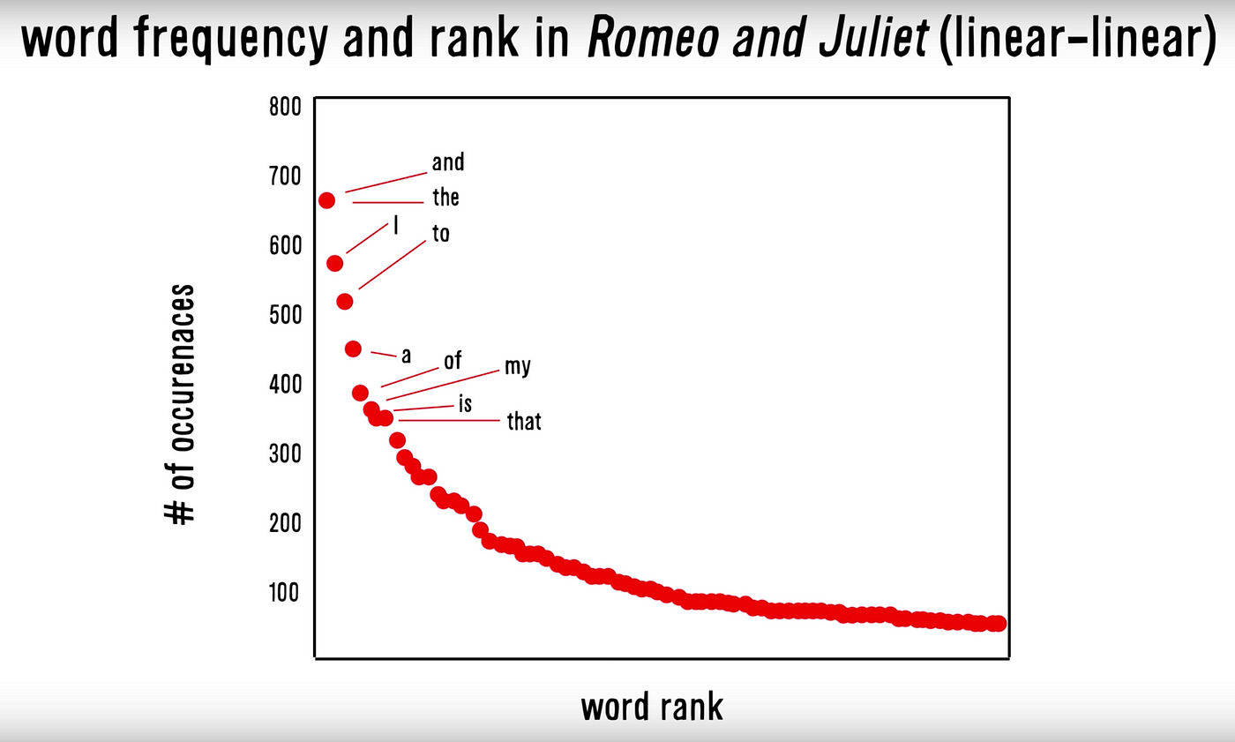
Zipf’s Law

Slide 24
Bag of words decisions
Stemming
Removing suffixes of words
Run: run, running, runs, runner
Hope that it’s correct most of the time
Lemmas
Grouping together inflected forms of a word
Run: run, running, runs, ran
Stop words
Natural language words with little meaning

Slide 25
But also numeric data choices
Term of office
1.Term of office a. Over 8 years 1.00 b. 6 to 8 years 0.75 c. 5 years 0.50 d. 4 years 0.25 e. Under 4 years or at the discretion of appointer 0.00
Objective
8. Objectives a. Price stability is the major or only objective in the charter, and the central bank has the final word in case of conflict with other government objectives 1.00 b. Price stability is the only. objective 0.80 c. Price stability is one goal, with other compatible objectives, such as a stable banking system 0.60 d. Price stability is one goal, with potentially conflicting objectives, such as full employment 0.40 e. No objectives stated in the bank charter 0.20 f. Stated objectives do not include price stability 0.00

Slide 26
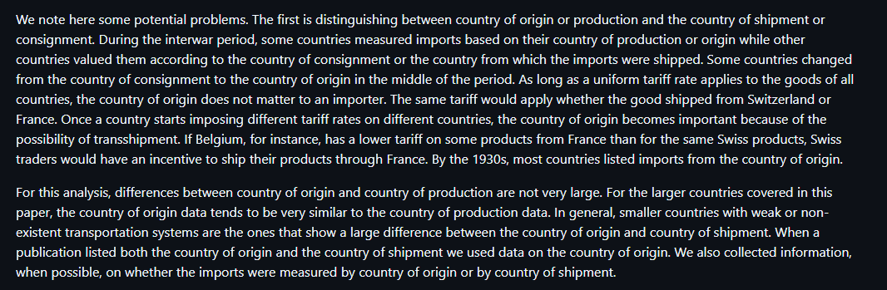
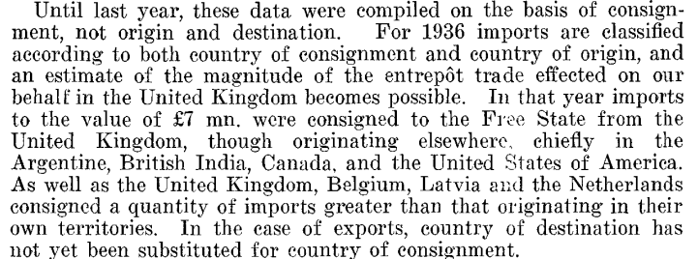
Trade data

Slide 27
Bag of words steps
Tokenize text – convert text to individual features
Create matrix with documents as rows and tokens as columns

Slide 28
FRUS 1945 vol. 06 doc. 43
Postwar imports, while of a somewhat different composition than present imports, will be somewhat greater. Food imports will increase. Moreover, world prices are tending upward. Lord Keynes felt that the combined purchases “bluff” was beginning to lose effect and that prices generally would increase by 20%.
Keynes thinks that there may be no net increase in manpower in the export trades. Keynes and Eady pointed out that it is very difficult to take the right decision with respect to the Japanese war effort. If the British release more manpower, public opinion in the United States will say that they are not doing enough for the Japanese war. Keynes pointed out that the present military assumptions are that a full Japanese war pipeline must be maintained to December 31, 1946. This seems absurd and Keynes believes that perhaps we should reconsider and begin to taper off.
In arriving at these deficit estimates, Keynes is including some 300 million of additional overseas expenses into the sterling blocked balances to be added to the war settlement with the sterling area. Zero day for blocked balances would be several months after V–J.

Slide 29
Frequencies
Paragraph 1 |  | Paragraph 2 |  | Paragraph 3
imports | 3 | the | 7 | the | 3
prices | 2 | that | 6 | balance | 2
somewhat | 2 | keynes | 4 | be | 2
that | 2 | to | 4 | blocked | 2
will | 2 | and | 3 | sterling | 2
 |  | in | 3 | to | 2
 |  | japanese | 3
 |  | are | 2
 |  | be | 2
 |  | increase | 2

Slide 30
Bag of words matrix
 | Postwar | imports, | while | of | a | somewhat | Different | Composition | than
r1 | 1 | 3 | 1 | 1 | 1 | 2 | 1 | 1 | 1
r2 | 0 | 0 | 0 | 0 | 1 | 0 | 0 | 0 | 0
r3 | 0 | 0 | 0 | 1 | 0 | 0 | 0 | 0 | 0

Slide 31
Storing text data – sparse matrices
Most elements of document-feature matrix are 0
Words do not appear in all documents
Inefficient (i.e., matrix too big)

Slide 32
Sparse matrix
 | postwar | imports | while | of | of | a | a | Somewhat | different
Row | 1 | 1 | 1 | 1 | 3 | 1 | 2 | 1 | 1
Word | 1 | 2 | 3 | 4 | 4 | 5 | 5 | 6 | 7
Freq | 1 | 2 | 1 | 1 | 1 | 1 | 1 | 2 | 1

Slide 33
Vectors
3 different vectors rather than dense matrix
1) frequencies of token in each document
One element for every token-document
2) feature index for each token in 1)
Lengths of 1) and 2) same
3) frequency index where document starts
Elements = number of documents + 1
Also be a vector storing token names

Slide 34
